Slide 1

Managing State with useState and useReducer
React's two primary built-in state management hooks power 87% of React applications today.
Released in February 2019 with React v16.8, these hooks are essential tools for building dynamic, interactive experiences.

Slide 2


What is State in React?
State Fundamentals
State is data that changes over time within your components. It drives UI updates automatically when modified.
It persists between renders but resets when components unmount.
React's declarative approach transforms state into UI through the render process.

Slide 3
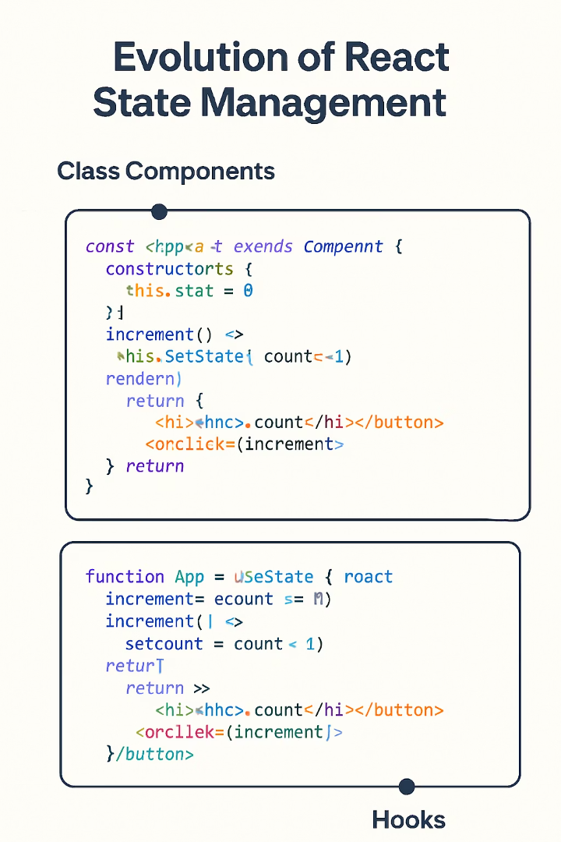
Component State Evolution
1
Class Components Era
Using this.state and this.setState() for managing component data
2
Hooks Introduction
Release of useState and useReducer in React 16.8
3
Modern React
72% of developers prefer hooks-based approach over classes

Slide 4
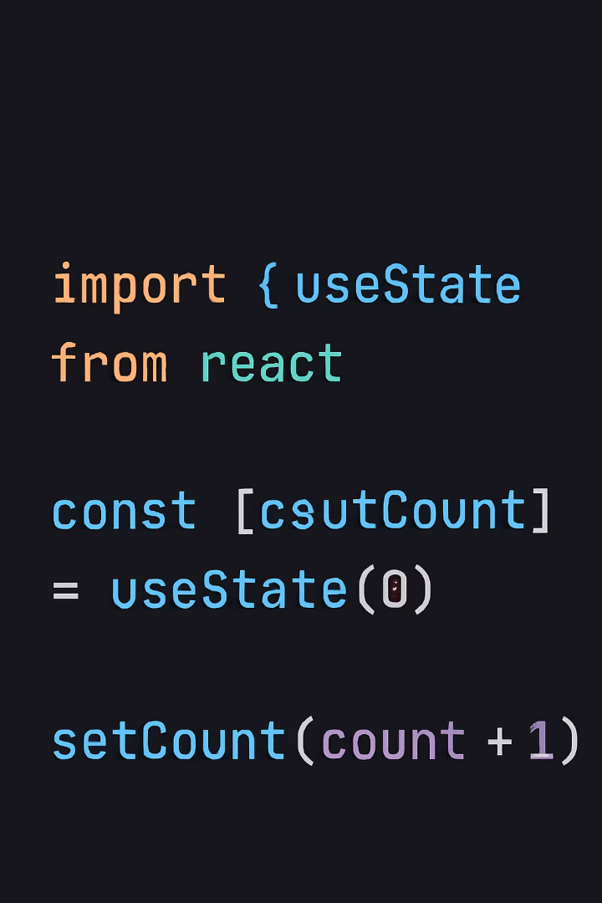
useState Hook: The Basics
Import and Initialize
Import useState from React and call it with an initial value
Destructure Return Value
Get state value and setter function via array destructuring
Update State
Call the setter to update state and trigger re-rendering

Slide 5

useState Examples
Primitive Values
Form Inputs
const [count, setCount] = useState(0);
const [email, setEmail] = useState('');
const [name, setName] = useState('');
const handleChange = (e) => setEmail(e.target.value);
const [isActive, setIsActive] = useState(false);
Complex Objects
const [user, setUser] = useState({ name: '', age: 0 });
setUser(prev => ({...prev, name: 'John'}));

Slide 6





useState Best Practices
Keep State Minimal
Store only essential values. Derive calculations from state when needed.
Use Functional Updates
Update based on previous state: setCount(prev => prev + 1)
Split Complex State
Use multiple useState calls instead of deeply nested objects.
Use Key Prop Strategically
Reset child component state with key changes.

Slide 7










useState Limitations
Complex Logic
Hard to maintain as state interactions grow
Synchronization Issues
Multiple related values become difficult to coordinate
Tracing Difficulty
State transitions spread across component code
Testing Complexity
More setup required for comprehensive tests
Code Duplication
Similar state logic repeated in multiple components

Slide 8
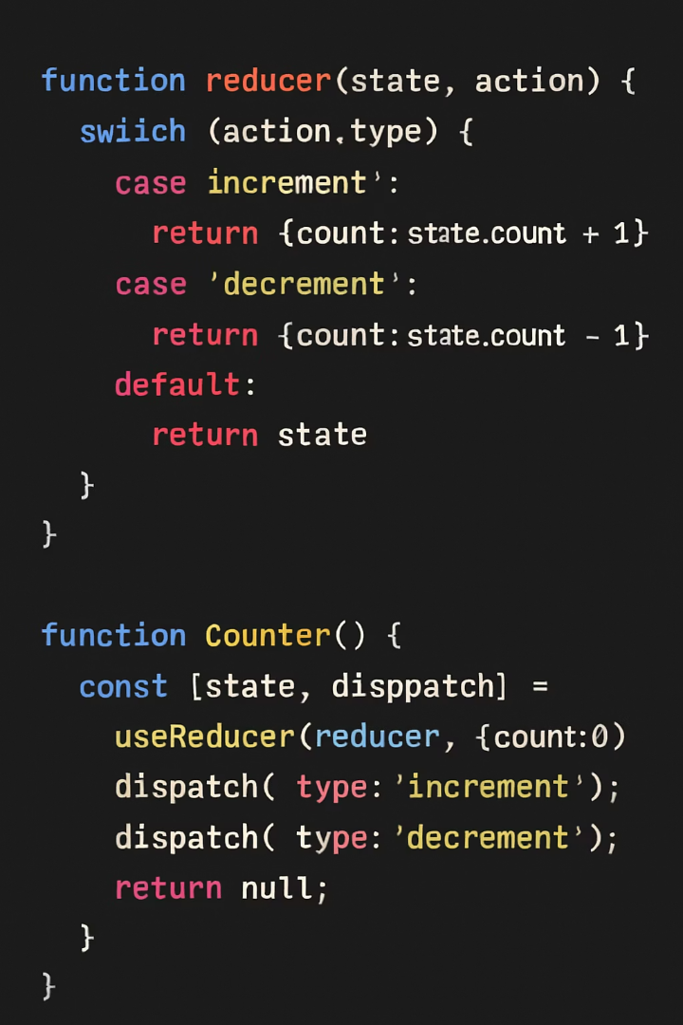




useReducer Hook: The Basics
Create Reducer Function
Define (state, action) => newState pattern
Initialize useReducer
Call hook with reducer and initial state
Use Dispatch Function
Send actions to update state: dispatch({ type: 'increment' })
Access State
Use current state value from hook's return array

Slide 9
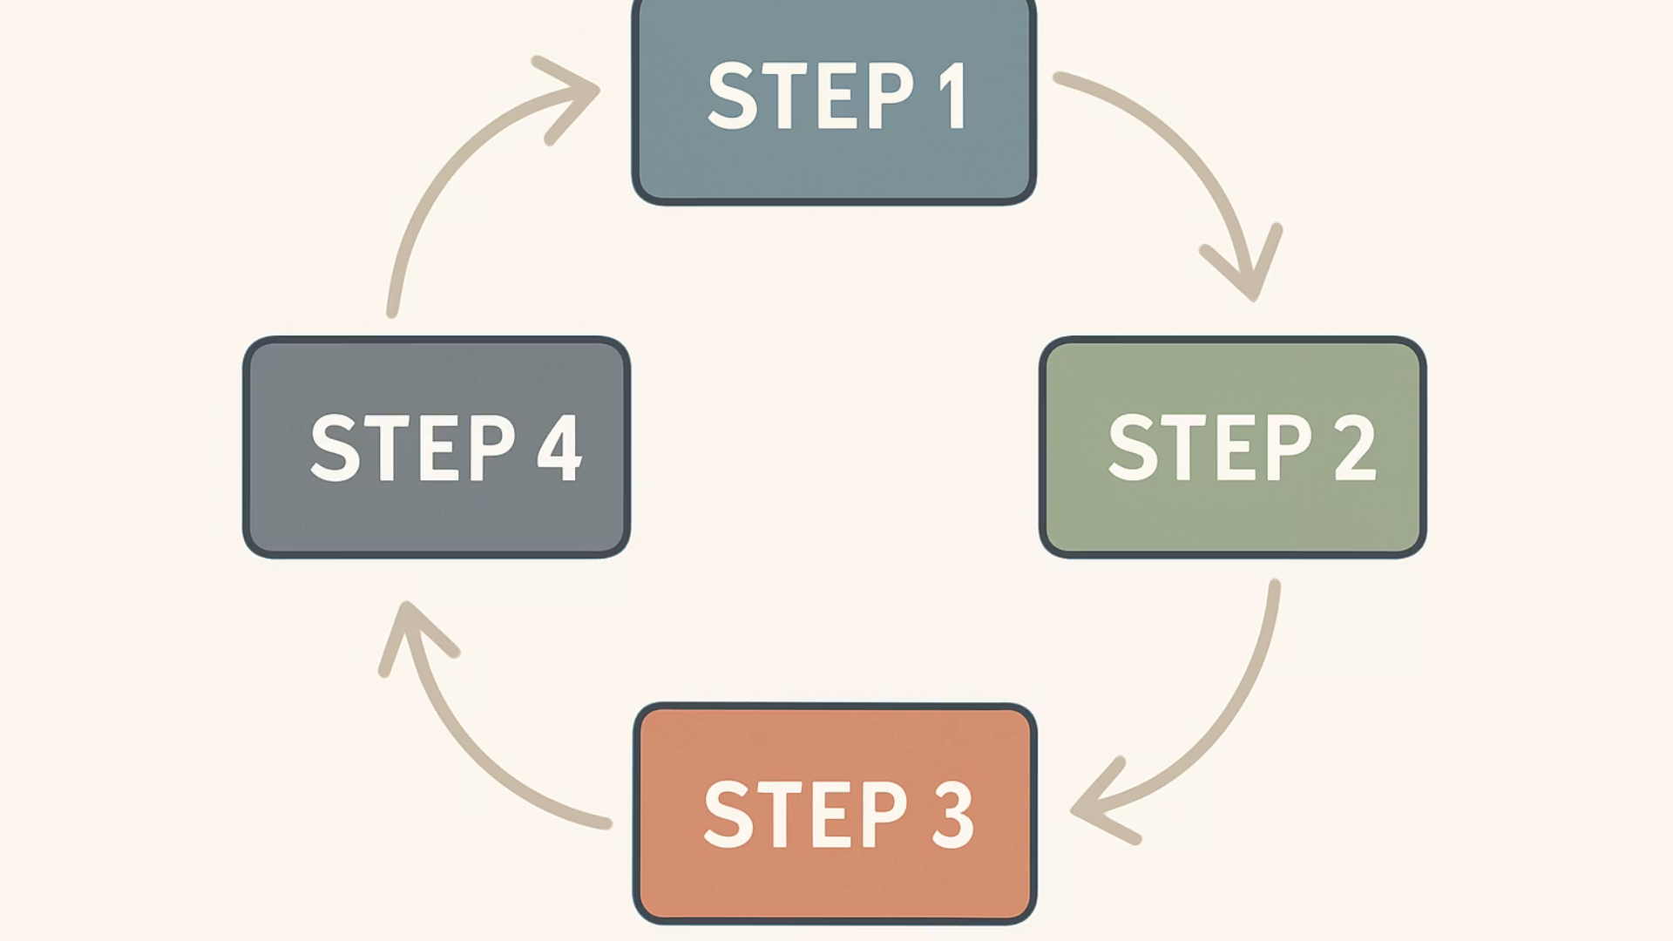

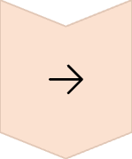
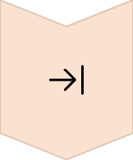
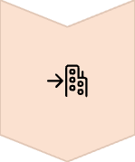
Anatomy of a Reducer
Initial State
Define starting state object with all required properties
Action Dispatched
Object with type property describing what happened
Reducer Processes
Pure function determines state changes based on action
New State Returned
Completely new state object triggers re-render

Slide 10

When to Choose useState vs useReducer
Scenario
useState
useReducer
State complexity
Simple, independent values
Complex objects with relationships
Update logic
Straightforward updates
Complex state transitions
State location
Local component state
Shared logic across components
Code organization
Minimal state logic
Centralized state management

Slide 11








Combining Both Approaches
UI State
Domain State
Use useState for simple interface states like isOpen or currentTab.
Apply useReducer for complex data like users, products, or carts.
Context + Reducer
Custom Hooks
Combine Context API with useReducer for global state management.
Compose both hooks in custom hooks for reusable logic patterns.

Slide 12




Key Takeaways
Choose the Right Hook
Optimize State Structure
useState for simple, independent state values; useReducer for complex, related state objects
Split complex state, avoid deep nesting, and keep related values synchronized
Follow Best Practices
Combine Approaches
Use function updates for derived state, leverage the key prop, and centralize complex logic in reducers
Use useState for UI state, useReducer for domain state, and custom hooks for reusable patterns

